Slide 1

Health Care Safety Redefined

Slide 2
Safety and Environment of Care is the #1 cited deficiency in healthcare
Increased regulatory/licensing entities burden from The Joint Commission, state (QUAPI), OSHA, etc
Healthcare institutions are required to have a safety committee and safety management plan
Records are maintained separately by various support services groups and documented on paper forms
The marketplace lacks a sufficient platform to track, trend, and communicate deficiencies causing undo harm to patients and staff

Slide 3
Vision:
  Provide every patient, caregiver, employee and guest the safe and secure healthcare environment they expect and deserve through a web and mobile safety software platform
Solution:
  Create a web and mobile integrated support service electronic facility record (EFR) system to help healthcare providers with compliance and efficiency
  Integrated systems that allow for each support service department’s activities to be captured and automated workflows
  Focus on core flows of the healthcare safety needs:
    General Safety / Emergency Preparedness / HAZMAT and Environmental Waste / Life Safety / Medical Equipment / Security / Utility Systems
Notes:
1) The focus now is on physician and nursing documentation and the integration / implementation of electronic medical records. We believe the next phase of integration and electronic records will be support services that will answer the regulatory burden, communication and safety.

Slide 4




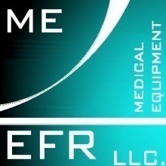






Slide 5


Maximize efficiency of the organization
Allow staff to complete surveys, audits and observations
Streamline workflows and expedite issue resolution improving compliance
Accountability
Instant Communications
Speed of Resolution
Direct Reporting
Automated Compliance
Picture Uploads

Slide 6

Allows real-time documentation of deficiencies noted utilizing a mobile device
Capable of photographic capture
Selection of deficiency type from drop down window
  Life Safety
  Biohazard
  Security
  Medical Equipment
  General Safety
  Utilities
  Emergency Preparedness
  OSHA
  Patient Safety
  State/Federal Tags

Slide 7










Slide 8







Slide 9

The software will immediately send off an email notification to the responsible parties that a deficiency have been found
The responsible party logs into software to retrieve list of deficiencies
The responsible party corrects the deficiency and documents corrective measures in the software and system automatically records entry and status.
The software then sends a notification email to the safety officer that entries have been addressed.
The safety officer and user will be able to monitor activities and complete or outstanding entries
The software will trend the type of deficiencies noted and the department (life safety, security, etc.) and display in chart format to identify problematic areas

Slide 10

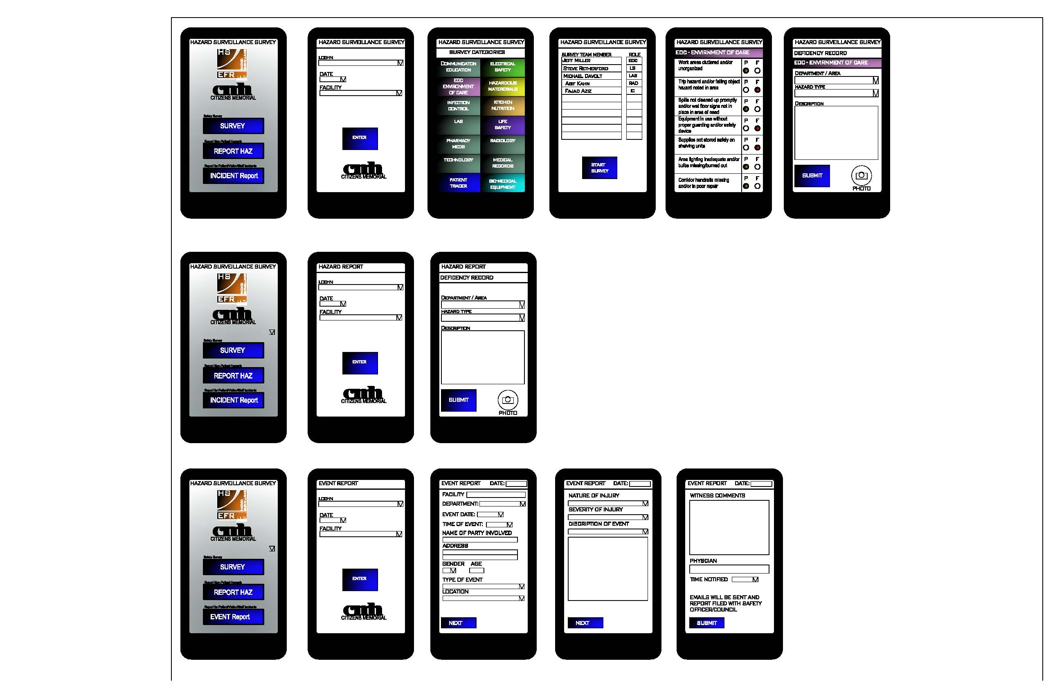

Slide 11


Slide 12


Slide 13
MARKETS - Healthcare
Industry
Industry
Hospitals
5,754 –Total Hospitals
941,955 Staffed Beds
Long Term Care Revenues - $258 B
87,000 – Facilities
3.6 million units
Focus: Assisted living – fastest growing
1 million Assisted living unit
High
Hospitals
Assisted
Living
Skilled
Nursing
Service Intensity
Independent
Living
Low
Low
Level of Need
High
Notes:
IL: condo like with room, meals and activities
AL: home like; assistance with daily activities. Higher margin business, mostly private pay
SN: generally institutional; reimbursements tied to specific care
Senior living industry
All professionally managed
highly fragmented - top 25 operators owning about 10%-15% market share
Assisted Living Market Opportunity:
Fastest growing segment because seniors don’t want to be in the skilled nursing
Estimated Market Value: $30 billion
Challenges:
-compliance – federal and state level requiring more transparency
-op. efficiency – 40-60% of operating expense is tied to clinical care
-dissatisfied staff due to paper work compared to care related work

Slide 14
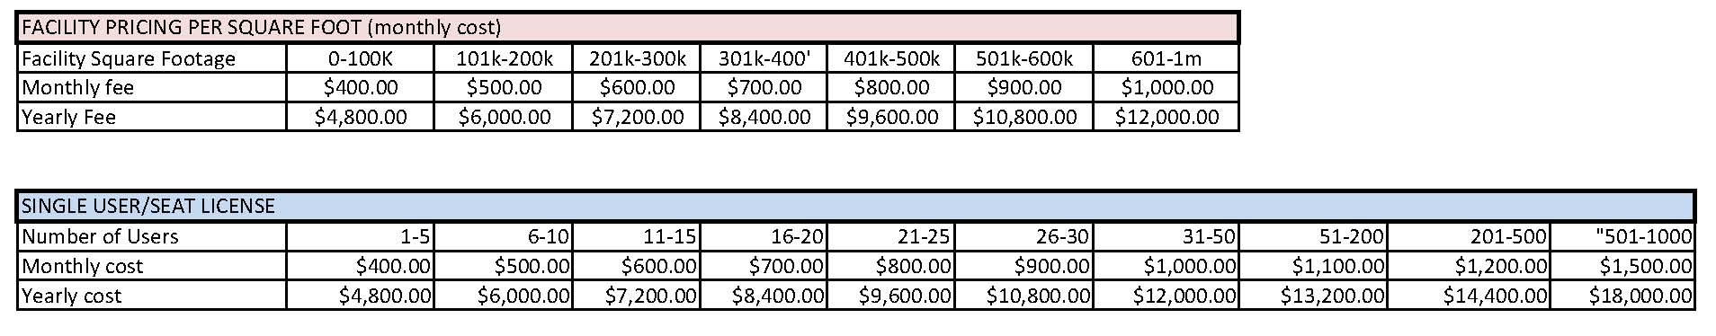
10% Market share of Healthcare Facilities (Hospitals, LTC & Assisted Living)
  5,754 Hospitals x 10% = 580
  87,000 LTC & Assisted living x 10% = 8,700
  Total = 928 facilities
Average Pricing (low end bracket) = $400 monthly or $4,800 annually
  $4,800 x 9,280 = $44,544,000

Slide 15

EFR is the solution facilities need to integrate documentation, increase communication, create a more efficient and effective work flow and meet current and future regulatory requirements for support services
Benefits:
  Integrated documentation
  Increased communication
  Improved workflow efficiency and effectiveness
  Regulatory compliance

Slide 16

General Safety
Safety Council Meeting Minutes and Action Plans
Policy and procedure changes
Accident / incident analysis
Patient and visitor events
Property / security incidents and activities
Hazard surveillance findings
Hazardous materials and wastes incidents
Emergency preparedness activities
Life and fire safety incidents, alarms and drills
Orientation and education activities
Reports
Life safety systems – Plant Facilities and Security
Medical equipment – Bio-medical Engineering
Utility systems – Plant Facilities
Radiation safety - Radiology
Laboratory safety – Laboratory
Regulatory agency surveys / mock survey activities – Performance Improvement
Blood and body fluid exposures – Infection Prevention

Slide 17

Emergency Preparedness
Link to Emergency Response Plan
Risk Assessments
Hazard vulnerability analysis
96 hours sustainability form
Memorandum of understanding agreements
Incident Command / NIMMS / EOC / Action Sheets
After actions report
Annual Evaluation

Slide 18

HAZ Mat & Waste
Link to safety data sheets and chemical book in ED
Labeling (GHS) compliance
Link to CDC poison center
Hazardous waste Manifest
Annual Evaluation
Facility drawings to identify high risk areas
Link to Policy
Contracts

Slide 19

Life Safety
CMS (joint commission) and/or State
Statement of Conditions
NFPA
Risk Assessments
Equivalencies
Interim Life Safety Measures
Annual assessment
Reports and Logs
Fire alarm inspection
Sprinkler
Fire drill documentation
Fire / Smoke Wall inspections
Fire /Smoke Dampers
Fire/ Smoke Doors
Ansul System
Facility drawings
Link to Policy

Slide 20
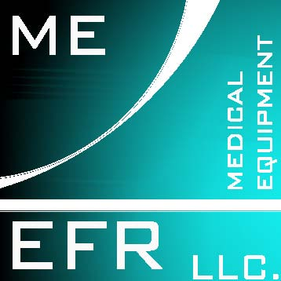
Medical Equipment
Joint Commission standards
Equipment List (Critical vs Non-critical)
Third party / Rental
Contracts
Log for new equipment purchase and tracking
Link to policy
Annual Assessment
Risk Assessments
Capital equipment tracking (depreciation)
Preventive maintenance (PM’s )
Maintenance work orders
FMEA – Failure Mode Effects Analysis
RCA – Root Cause Analysis

Slide 21

Security
Link to policy
Facility drawings identify high risk and sensitive areas
Contracts
Education competencies
Risk assessments
Actions to be taken in the event of a security incident
Lost and found
Situations involving VIP’s and the media
Hostage or kidnapping situations
Civil disturbances or bomb threats
Provisions for providing additional personnel to control traffic during emergencies
Annual Assessments

Slide 22

Utility Systems
Contracts
Electrical
HVAC
Plumbing / water system
Sprinkler system
Fire alarm
Medical Gas testing / Alarms
Generator testing log
Link to policy
Annual Assessment
Risk Assessments
UPS Systems
Negative pressure testing

Slide 23

Environmental Services
Performance improvement activities
Daily Log Sheets
Environmental Inspections
Laundry Poundage
Eye Wash station checks/logs
Cost Tracking
Policies
Contracts

Slide 24

Food Services
Performance improvement activities
Food temps
Inventory control
Vendors/suppliers
POS
Menu software / bedside education
Cost Tracking
Special Events Reservations / Catering
Policies
Contracts

